Slide 1
Multi-Label Supervised Contrastive Learning
Pingyue Zhang Mengyue Wu
MoE Key Lab of Artificial Intelligence, AI Institute
X-LANCE Lab, Department of Computer Science and Engineering
Shanghai Jiao Tong University, Shanghai, China
Presentation：Chen Ning
Supervisor：Shen-Huan Lyu
Date: 5/4/2024

Slide 2
Table of Contents
1
Introduction
2
Related Work
3
Proposed Method
4
Experiments
5
Questions & Thoughts

Slide 3
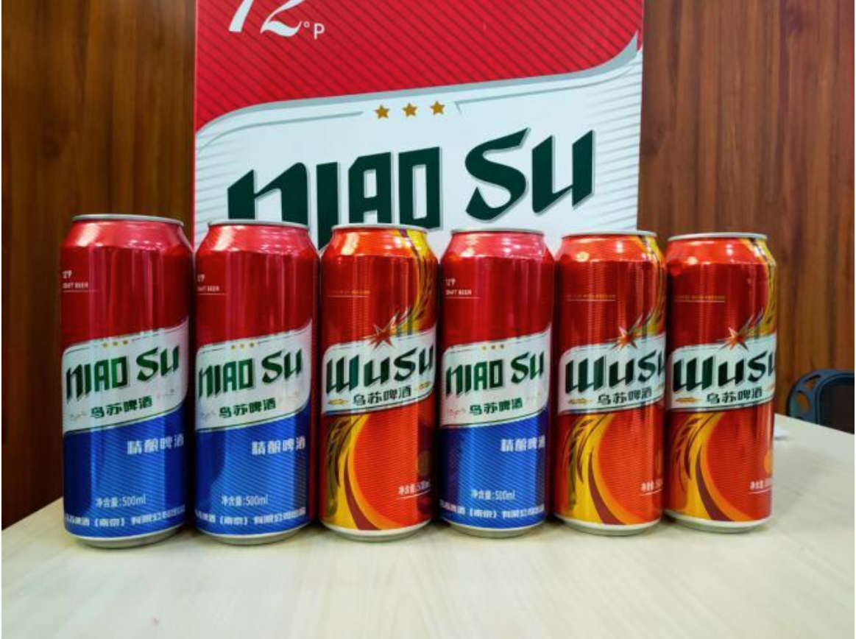
Introduction
Contrastive Learning
The core objective of contrastive learning is to train models to distinguish between differences among different samples.

Slide 4

Introduction
The shortcoming of the some current methods
They focus on the correlation between sample and label set.

Slide 5
Introduction
A key question
An intuitive question would be, should we consider one sample as positive when its label set partially overlaps with or exactly matches the anchor’s?
How can we represent this correlation in loss functions.
Article’s method
Focus on mainly capturing the correlation between samples
Analyze the correlations between two sets of labels, instead of directly using the label information itself.

Slide 6
Table of Contents
1
Introduction
2
Related Work
3
Proposed Method
4
Experiments
5
Questions & Thoughts

Slide 7
Related Work
Multi-label Classification
Divide a sample into multi-individual label
RNN and CNN
Graph Convolutional Network
Dao et al. utilize contrastive learning to lean multiple label-level representations from each sample.
Notes:
对于一张同时包含“海滩”、“日落”和“人”的图像，传统的单标签或多标签分类模型可能会为整张图像学习一个单一的特征向量，用于预测所有可能的标签。然而，这种方法可能无法很好地捕捉到每个标签的独特视觉特征。
相比之下，当我们谈论多个标签级别的表征时，模型会为每个标签学习一个独立表征。例如：
对于“海滩”标签，模型可能会学习到与沙子、海水和海岸线相关的特征。
对于“日落”标签，模型可能会关注图像中的橙色、红色和黄色色调，以及太阳接近地平线的位置。
对于“人”标签，模型可能会专注于检测图像中的人物轮廓、肤色和姿态。
在训练过程中，模型通过比较不同样本中相同标签的表征来学习。例如，来自不同图像的“海滩”标签的表征应该彼此相似，而与“日落”或“人”标签的表征则应该有所区别。这种比较可以通过对比损失函数来实现，它鼓励相同标签的表征相互靠近，而不同标签的表征相互远离。

Slide 8
Related Work
Contrastive Learning
SimCLR (Chen et al. 2020) advises hard data augmentation and more negative samples for effective representation learning
MoCo (He et al. 2020) uses a queue for contrastive learning with stored negative samples
SupCon (Khosla et al. 2020) improves single-label classification using a modified contrastive loss, allowing multiple positives for one anchor

Slide 9
Table of Contents
1
Introduction
2
Related Work
3
Proposed Method
4
Experiments
5
Questions & Thoughts

Slide 10
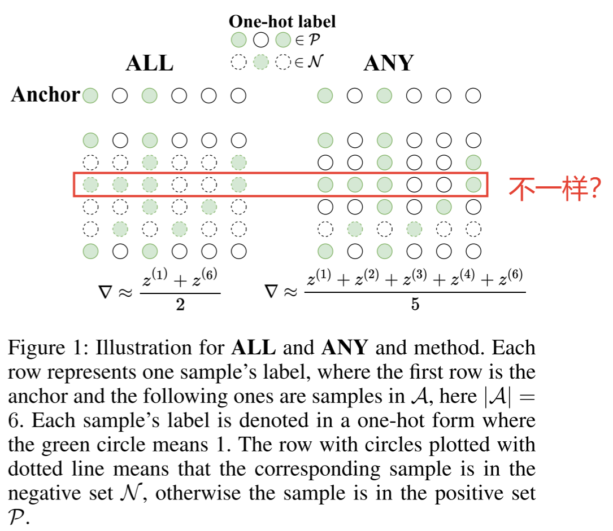
Proposed Method
Two Definition
Notes:
一个样本可能同时具有标签A和B，而另一个样本可能只有标签A。如果只考虑标签A，那么这两个样本都是正样本，但如果同时考虑标签B，那么它们的正样本状态就会有所不同
对于 ANY 而言，所有的正例都属于第三类别，然而对于第一类别而言只有三个正例，因此，第一类别将有更少的权重

Slide 11
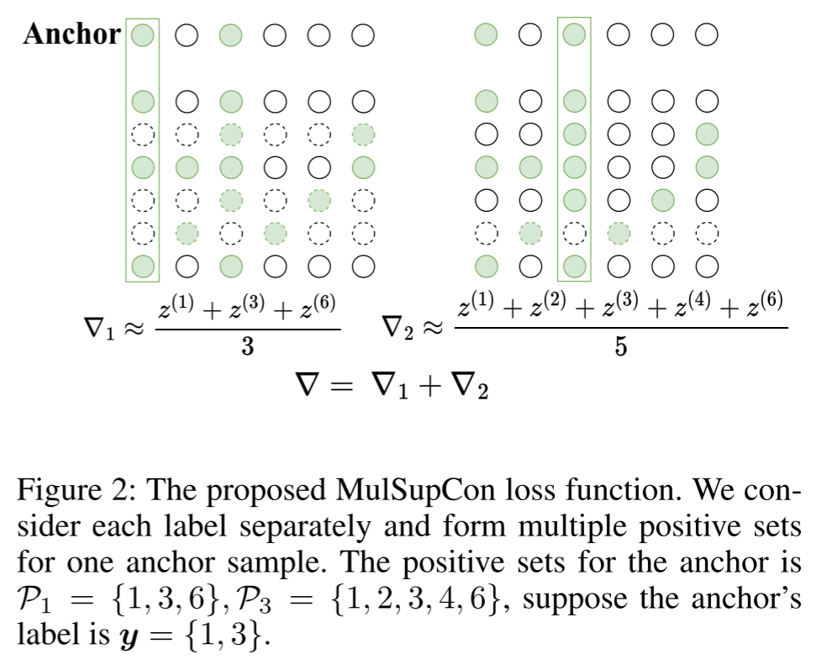
Proposed Method
The proposed loss

Slide 12
Table of Contents
1
Introduction
2
Related Work
3
Proposed Method
4
Experiments
5
Questions & Thoughts

Slide 13
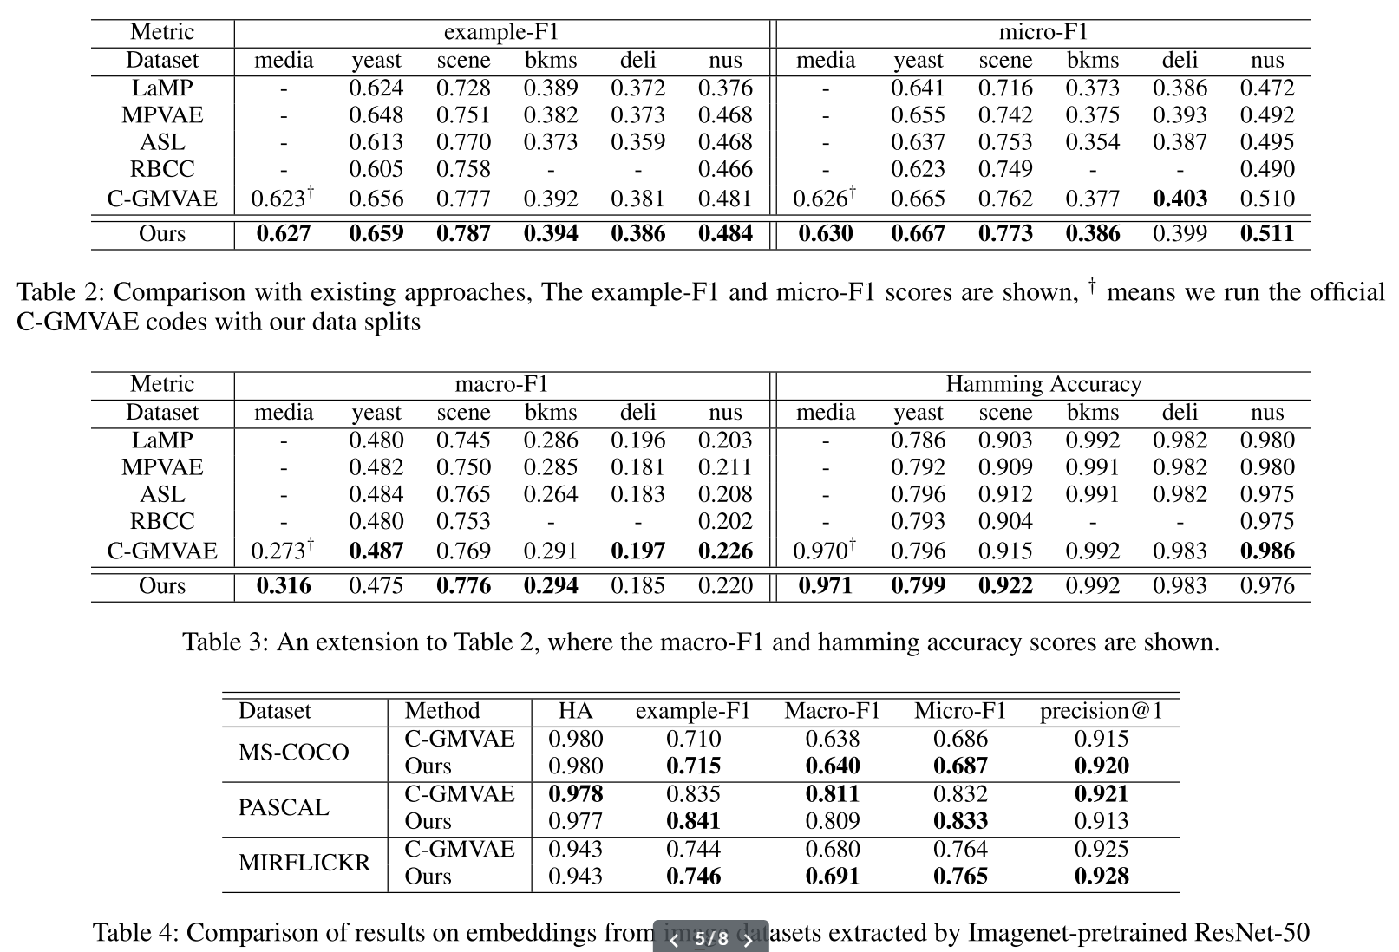
Experiments
Comparison with existing approaches

Slide 14
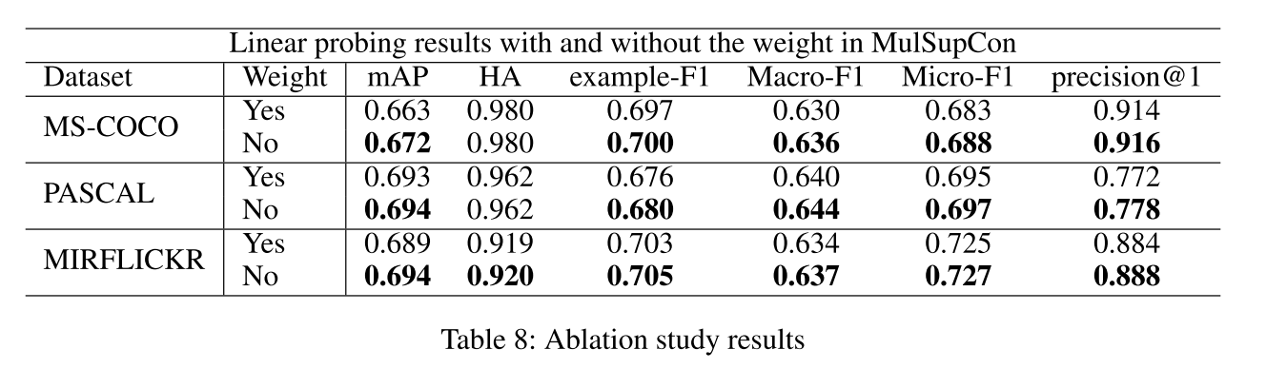
Experiments
Ablation Studies

Slide 15
Table of Contents
1
Introduction
2
Related Work
3
Proposed Method
4
Experiments
5
Questions & Thoughts

Slide 16
Questions & Thoughts
I don’t see a solution regarding the resolution of the relationship between the labels.
Whether we need to think the correlations of the positive labels.

